Slide 1
GEL FILTRATION CHROMATOGRAPHY
Presented By
K. Gayathri Devi, M. Pharm., (Ph.D.),
Assistant Professor,
Department Of Pharmaceutical Analysis,
MAM College Of Pharmacy,
Kesanupalli.

Slide 2
Gel Filtration Chromatography(GFC)
Mobile phase – liquid
Stationary phase – porous beads or material with a well defined range of pore size.

Slide 3
It separates molecules according to the differences in sizes as they pass through a gel filtration medium packed in column.
Unlike ion | exchange or | affinity | chromatography,
molecules | do not bind | to the | chromatography
medium.
It is generally used to separate biological molecules, and to determine molecular weights and molecular weight distributions of polymers.

Slide 4
The technique can be applied in two distinct ways:
Group separations:
components of a sample are separated into two major groups according to size range.
Small molecules such as excess salt (desalting) or free labels are easily separated.
High resolution fractionation of biomolecules: Components of a sample are separated according to differences in their molecular size.

Slide 5
Partition coefficient
Partition coefficient or distribution coefficient (k_{d}) is the basis of all types of chromatography.
For two immiscible phases, mobile and stationary phases, the value for this coefficient is a constant at a give temperature and is given by the expression;
k_{d} = molar conc: of analyte in stationary phase molar conc: of analyte in mobile phase
efective / average distribution coefficient ;
k_{av} = molecules absorbed in stationary phase molecules absorbed in mobile phase

Slide 6
Void volume
It is the volume of mobile phase (V_{m} or V₀) in a column.
In an ideal case, it is equal to the mobile phase hold-up volume.
For example, if the stationary phase occupies 40% of the total column volume, the void volume would be 60% of the total column volume.
Molecule that do not enter the matrix are eluted in void volume as they directly pass through the column as the same speed of buffer

Slide 7
The Role of the Partition Coefficient In Gel-Filtration Chromatography
V_{e}=v₀+k_{d} v_{i}
k_{d}=( v_{e}-v₀)/v_{i}
=(v_{e}-v_{o})/(v_{t}-v₀) since v_{t}=v₀-v_{i}
Where,
V_{e} is the volume at which the molecule of interest elutes or eluton volume.
V_{o} is the volume of the space between the beads;
V_{i} is the volume of the space in the beads;
V_{t} is total volume.

Slide 8
K_{d} have vales between 0-1.
If K_{d} = 0 (i.e.,if the analyte is large ,or if the molecule has no interaction with the resin and therefore passes around the beads instead of through the pores of the beads),
then
V_{e} = V_{o}, and the molecule will come out with the void volume.
If K_{d} = 1 (i.e., if the molecule is so small that it has full access to the pores of the beads), then V_{e} = V_{o} + V_{i}
= V_{t}, and the molecule will come out with the total volume

Slide 9
Due to variation in the pore size between indivedual gel particles, there is some inner mobile phase which are not avaiable and some available to analytes of intermediate size;
hence kd values may vary between 0-1.
For analytes of two different relative molecular mass and kd values k’d and k’’d,
the difference in their elution volumes,v_{e} can be, v_{e}=(k’d-k’’d)v_{i}

Slide 10
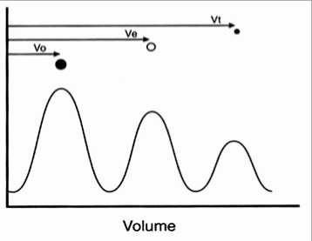
For very small molecules that have full access to the pores of the beads (small dots), V_{e} = V_{t}

Slide 11
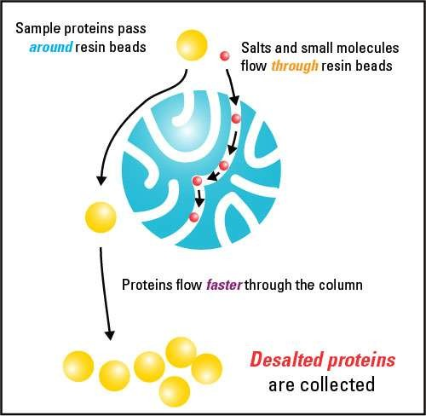
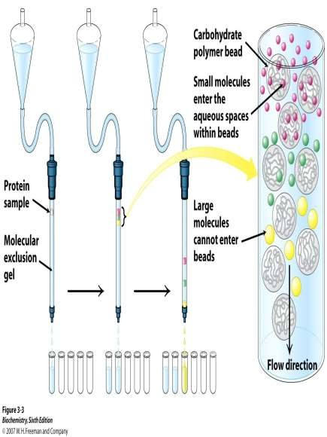
principle

Slide 12
A mixture of molecules dissolved in liquid (the mobile phase) is applied to a chromatography column which contains a solid support in the form of microscopic spheres, or “beads” (the stationary phase).
The mass of beads within the column is often referred to as the column bed.
The beads act as “traps” or “sieves” and function to filter small molecules which become temporarily trapped within the pores

Slide 13
Larger molecules pass around or are “excluded” from the beads .
Large sample molecules cannot or can partially penetrate the pores, whereas
only
smaller
molecules can access most or all pores.
Thus, large molecules elute first, smaller molecules elute later, while molecules that can access all the pores elute last from the column.
Particles of different sizes will elute (filter) through a stationary phase at different rates.

Slide 14
STATIONARY PHASE:
Semi-permeable, porous beads with well-defined range of pore sizes .
Beads are crosslinked polymers
Degree of crosslinking is controlled carefully to yield different pore sizes.
Smaller pore sizes are used for rapid desalting of proteins or for protein purification.
Intermediate pore sizes are used to separate relatively small proteins.

Slide 15
Very large pore sizes are used for purification of biological complexes.
Stationary phase used for gel exclusion chromatography include dextran (Sephadex™), polyacrylamide and dextran-polyacrylamide (Sephacryl™).
Each is available with a variety of different ranges of pore size in the beads, permitting separation of macromolecules of different size

Slide 16
A good stationary phase should have following properties:
It should be chemically inert.
It should be inexpensive.
It should not react with component to be separated.
It should not react with eluent.
It should be colorless, uniform in size and shape.
It should be mechanically stable.

Slide 17
Classification of gells
Soft gel
e.g.- dextran(Sephadex), Polyacrylamide gels Separation of proteins.
Semi-rigid gel e.g.- bio beads
Separation of non-polar polymers in non-polar solvents.
Highly rigid gels and glasses Separation of polar systems.

Slide 18
Mobile phase:
The liquid used to dissolve the biomolecules to make the mobile phase is usually called a buffer.
The mixture of biomolecules dissolved in the buffer is called the sample.
The choice of mobile phase to be used in any separation will depend on the type of separation to be achieved and component to be separated.
The solvent must dissolve the sample completely.
eg.-Tetrahydrofuran,Chloroform, Dimethyl formamide.

Slide 19
column
Shorter columns save time and solvent.
Small particles (typically 5 mm) provide a better resolution.
On the other hand, 5 mm (or even 3 mm) packings are more sensitive towards contamination by samples containing impurities.
Particles as large as 20 mm have been recommended for very high-molecular-weight polymers.
Columns with different porosity or mixed-bed columns, provide a better separation.

Slide 20
Advantages
Short analysis time.
Well defined separation.
Narrow bands and good sensitivity.
There is no sample loss.
Small amount of mobile phase required.
The flow rate can be set.

Slide 21
Disadvantages
Limited number of peaks that can be resolved within the short time scale of the GFC run.
Filtrations must be performed before using the instrument to prevent dust and other particulates from ruining the columns and interfering with the detectors.

Slide 22
Applications
Proteins fractionation
Purification (viruses,enzymes,hormones,nucleic acids)
Molecular weight determination(globular proteins).
Separation of sugar, proteins, peptides, rubbers and others on the basis of their size.
This technique can be determine the quaternary structure of purified proteins.

Slide 23
GFC is a widely used technique for the purification and analysis of synthetic and biological polymers, such as protein, polysaccharides and nucleic acid.
Various species of RNA and viruses have been purified using agarose gels.
For Desalting

